Slide 1



Modeling India Airline - XGBoost
Final Project for:
Data Science - Consulting Approach
Michał Grzyb, Marcin Miszkiel

Slide 2

AGENDA
Project Description
Modeling Approach
Description of the Data
Model Results
PowerBI Dashboard

Slide 3


Project description
The primary purpose of this project was to analyze and model the domestic and international flight data for Air India to gain insights into the factors influencing passenger numbers.
By understanding these factors, the goal was to build a predictive model that could accurately forecast the number of passengers carried, which could aid in strategic planning and operational optimization.
More Details

Slide 4


1
Data Cleaning and Preprocessing
2
Exploratory Data Analysis
3
Model Building
4
Evaluation
5
Feature Importance and SHAP Analysis

Slide 5

Description of the Data
DEPARTURES: The number of flights that have taken off in a given month.
HOURS: The total flight hours accumulated by the airline's fleet in a given month.
KILOMETER(TH): The distance flown by the airline, measured in thousands of kilometers.
PASSENGERS CARRIED: The number of passengers who flew with the airline during the month.
PASSENGER KMS. PERFORMED(TH): The number of passenger kilometers performed, measured in thousands.
AVAILABLE SEAT KILOMETRE(TH): The total number of seat kilometers during the month, measured in thousands.
PAX. LOAD FACTOR (IN %): The percentage of available seating capacity that is filled with passengers.

Slide 6
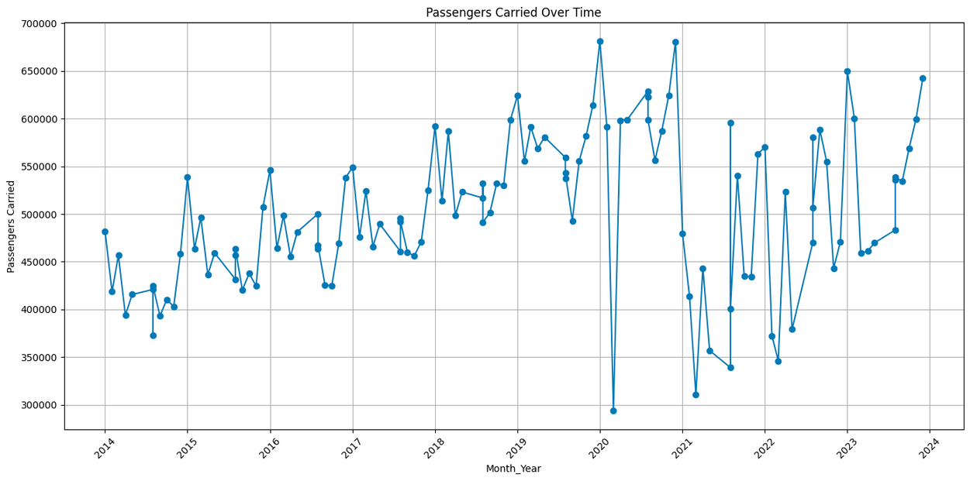

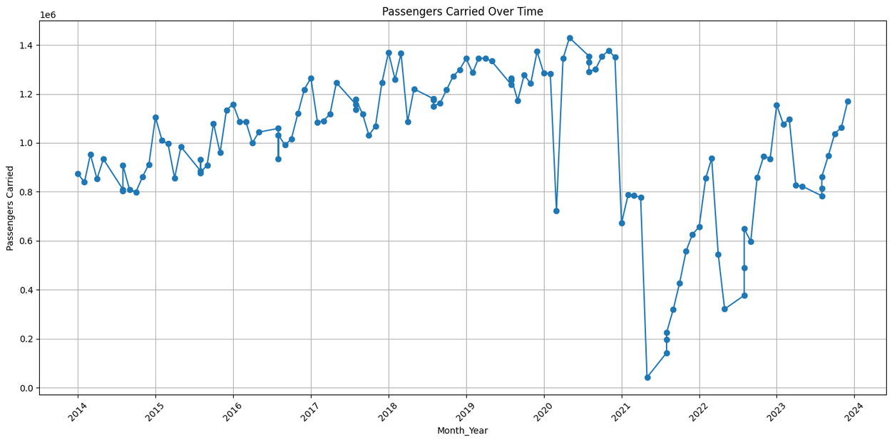
International
Passengers Carried
Domestic
Passengers Carried

Slide 7

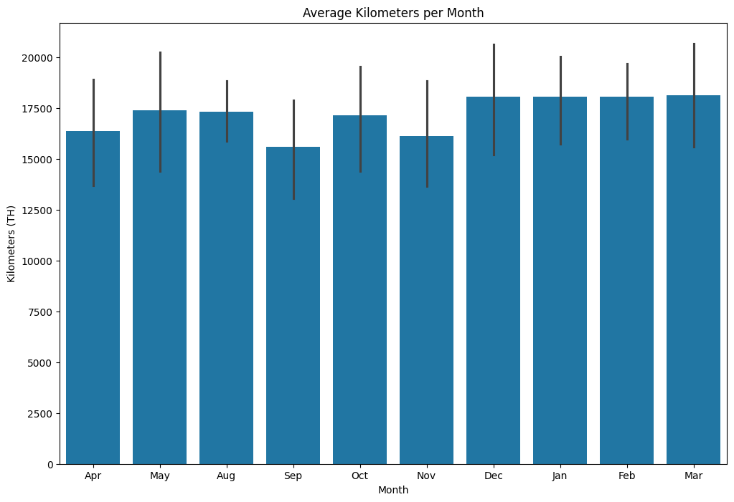

Slide 8
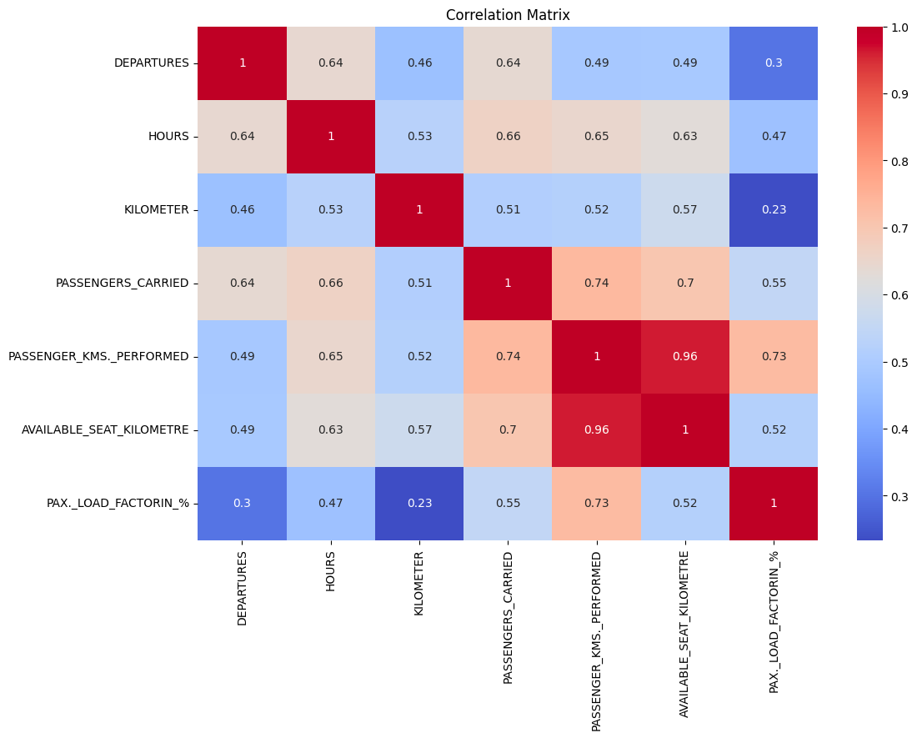
Strong Relationship between Capacity and Performance
Key Drivers of Passenger Numbers
Operational Efficiency
Flight Operations
Weaker but Relevant Factors

Slide 9

XGBOOST Results
Domestic
International
Root Mean Squared Error: 33381.562654950365
Mean Absolute Error: 26380.9453125
R-squared: 0.9869591420590705
Root Mean Squared Error: 40537.05897328483
Mean Absolute Error: 24193.983072916668
R-squared: 0.5566498783666725

Slide 10
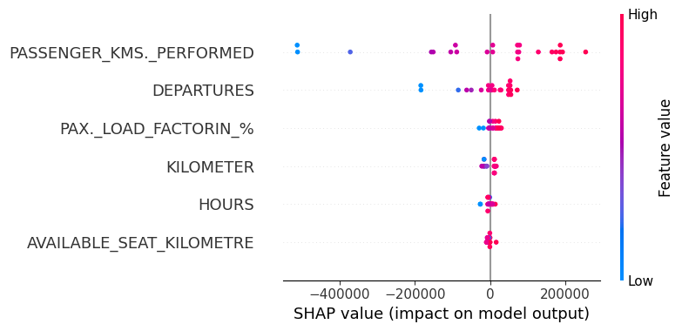

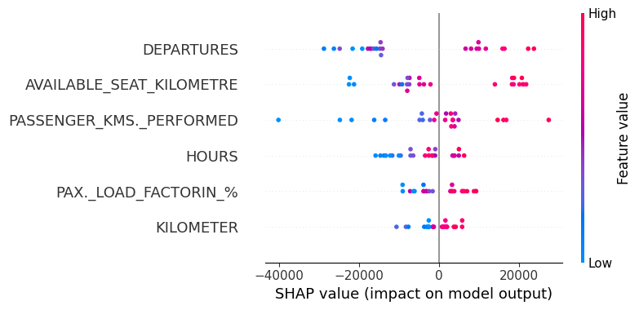
Domestic
International

Slide 11

Move on to the PowerBI Dashboard
Michał Grzyb, Marcin Miszkiel

